Slide 1
Gain model single neuron analysis
Hiroo Miyata

Slide 2
The dataset
Monkey: EARL
The time window: 200 ms before GC ~ GC
The amount of neurons: 152
The amount of trials: 492

Slide 3
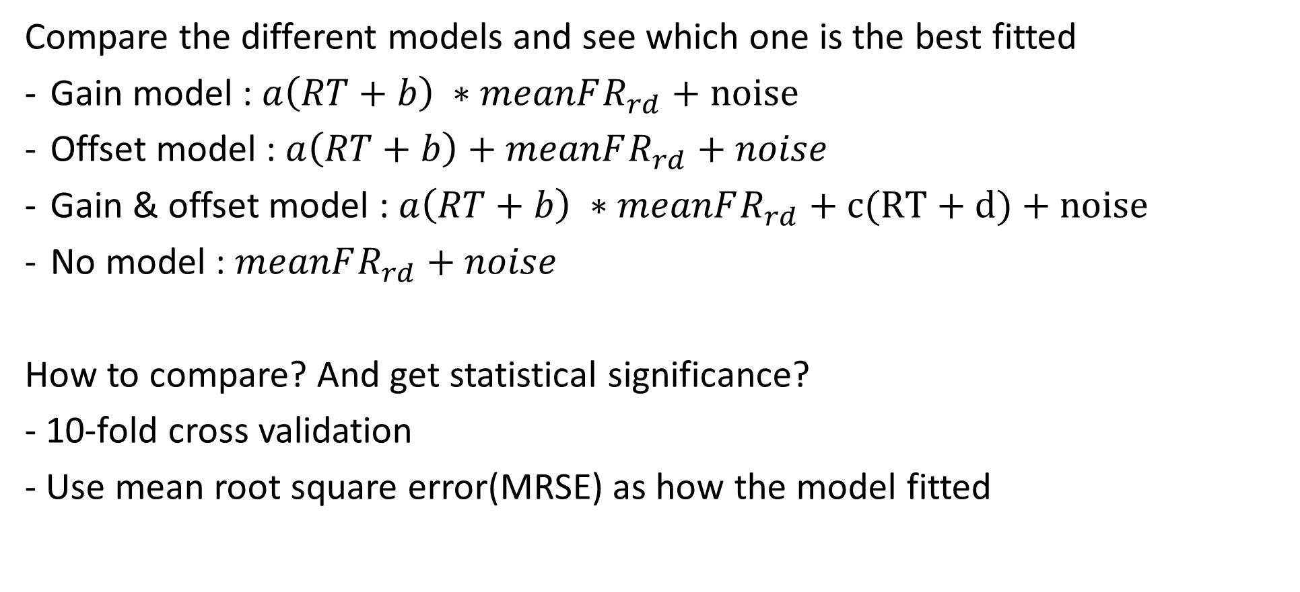
How to evaluate the gain model
Compare the different models and see which one is the best fitted
Gain model : $a\left(RT+b\right) ∗meanFR_{rd}+noise$
Offset model : $a\left(RT+b\right)+meanFR_{rd}+noise$
Gain & offset model : $a\left(RT+b\right) ∗meanFR_{rd}+c(RT+d)+noise$
No model : $meanFR_{rd}+noise$
How to compare? And get statistical significance?
- 10-fold cross validation
- Use mean root square error(MRSE) as how the model fitted

Slide 4
What we expect?
The MRSE would be
Gain & Offset = Gain < Offset < No
The expected results
MRSE of Gain model is lower than Offset model and it is statistically significant in every neuron
MRSE of Gain & Offset model is same as Gain model and it is no statistical significance in every neuron

Slide 5
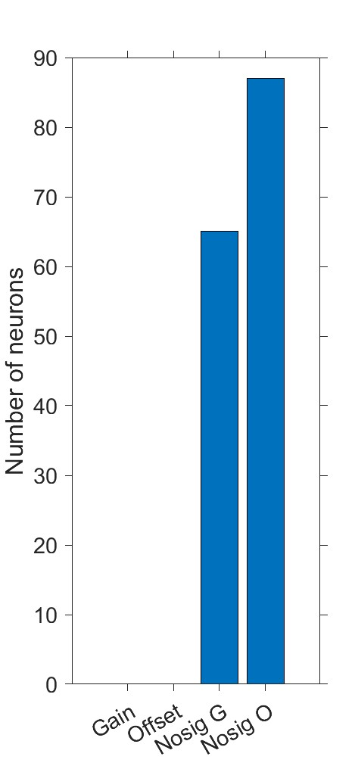
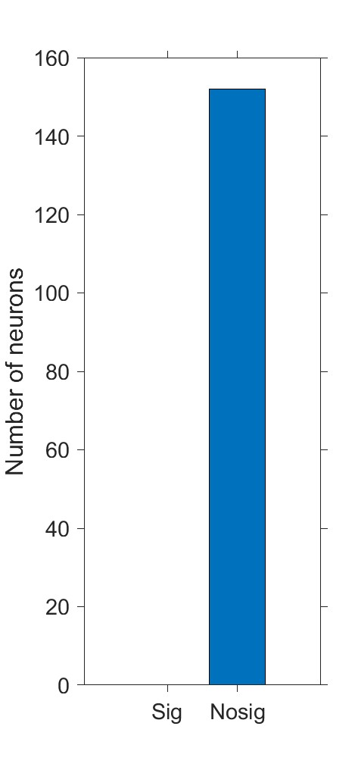
The results
Gain vs Offset
Gain vs Gain & Offset
X axis:
Gain < Offset and p < 0.05
Offset < Gain and p < 0.05
Gain < Offset and p > 0.05
Offset < Gain and p> 0.05
X axis:
p < 0.05
p < 0.05

Slide 6
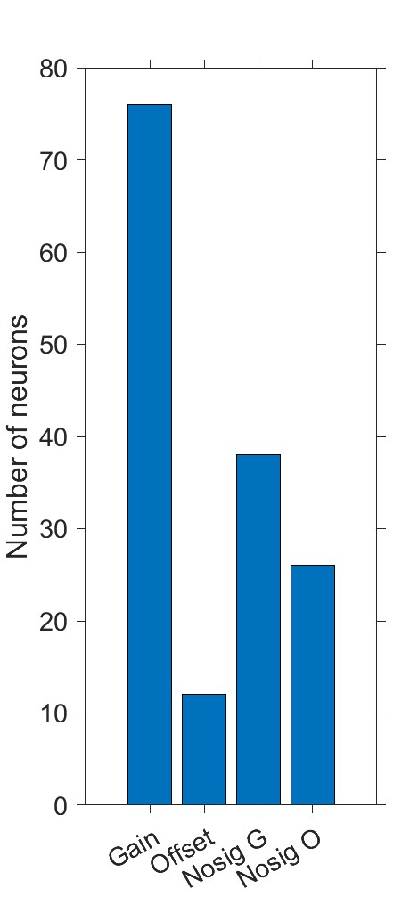
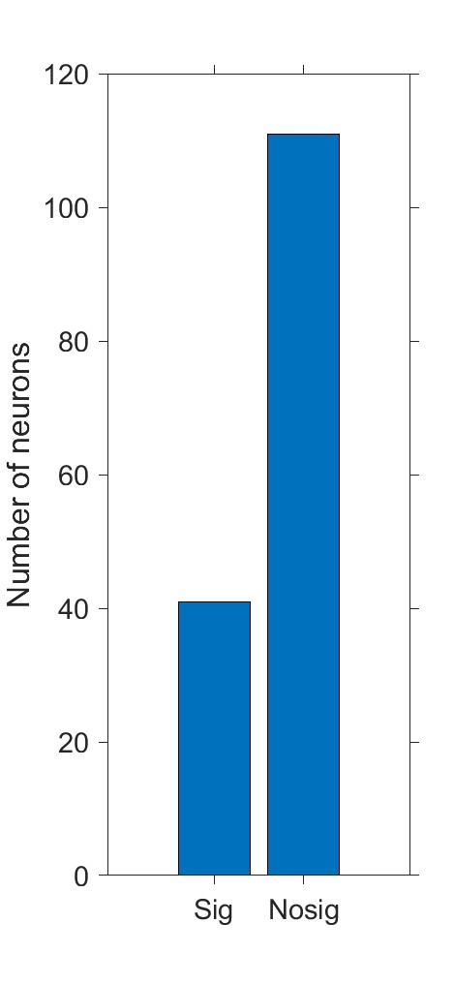
The results
Gain vs Offset
Gain vs Gain & Offset
X axis:
Gain < Offset and p < 0.05
Offset < Gain and p < 0.05
Gain < Offset and p > 0.05
Offset < Gain and p> 0.05
X axis:
p < 0.05
p < 0.05

Slide 7
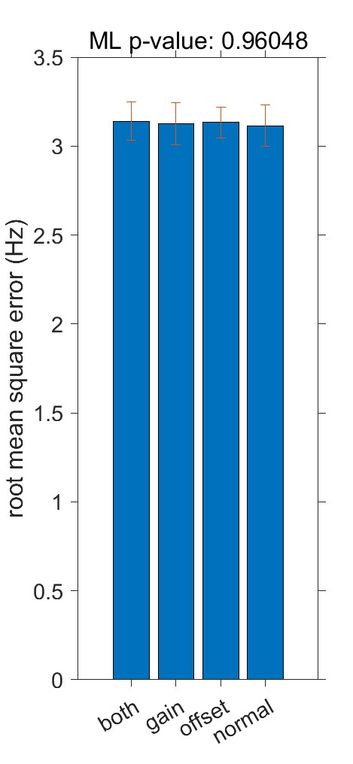
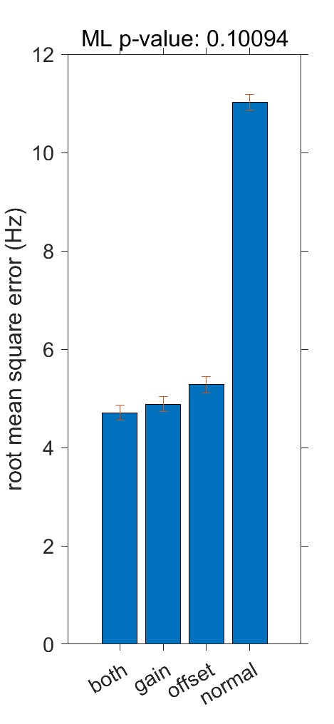
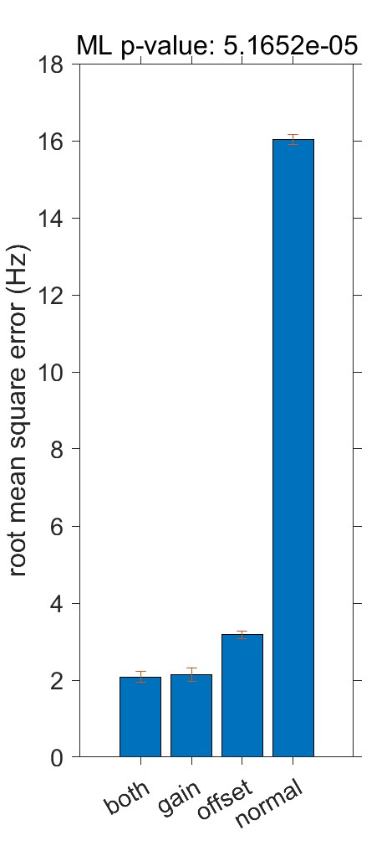
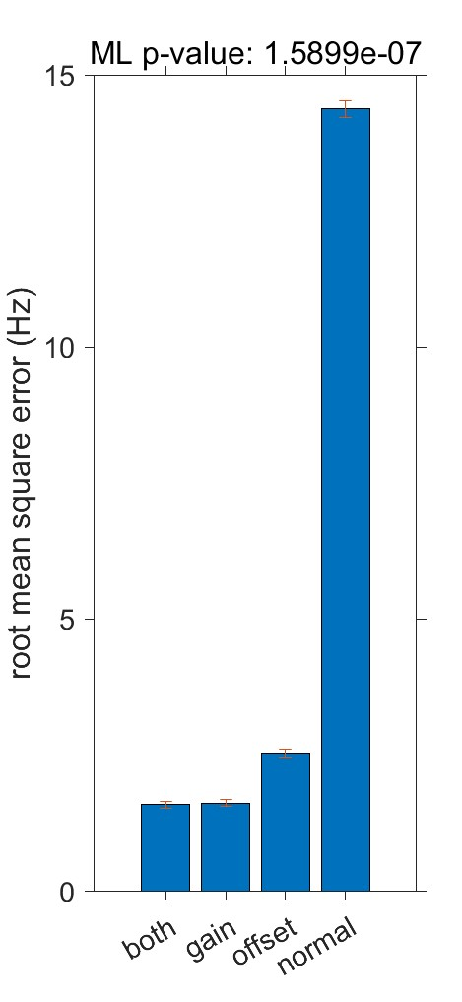
Show me the real data!
Noisy neuron
Not significant neuron
Great neurons

